Slide 1
Data Mining project
Sachini Weerasekara
Lai Peng

Slide 2

1. Problem setting
Dengue fever is carried by mosquitoes, its transmission dynamics are related to climate variables, such as temperature and precipitation.
An understanding of the relationship between climate and dengue dynamics can improve research initiatives and resource allocation to help fight Dengue fever.

Slide 3
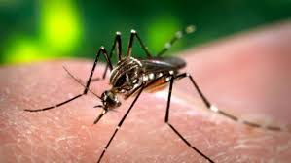
2. Problem definition
Based on climatic variables and non-climatic variables in our dataset, we aim to predict numbers of Dengue cases and class of Dengue cases for week of year for two cities San Juan and Iquitos.

Slide 4
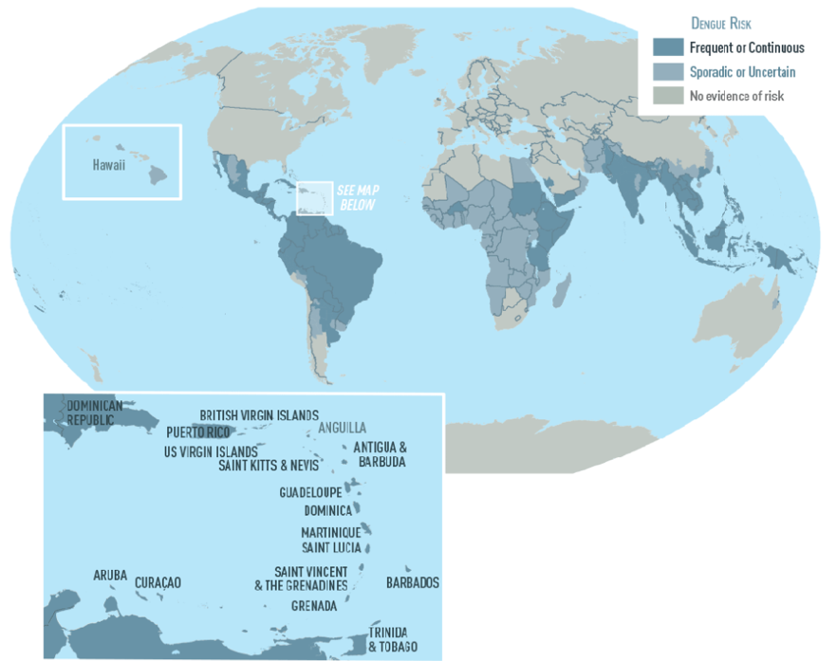
Four problems
Problem 1.1 : Classifying Dengue cases for week of year for San Juan as High, Medium, Low or Very High
Problem 1.2 : Prediction of total number of Dengue cases for week of year for San Juan
Problem 2.1 : Classifying Dengue cases for week of year for Iquitos as High, Medium, Low or Very High
Problem 2.2 : Prediction of total number of Dengue cases for week of year for Iquitos

Slide 5
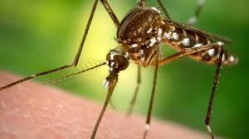
3. Data source
The source of the Dengue dataset is “Drivendata” and specific website address is: https://www.drivendata.org/competitions/44/dengai-predicting-disease-spread/page/82/

Slide 6

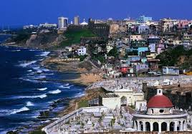
4. Data description
25 features and 1456 cases are included in the original dataset.
Considering the difference in geographies, it was assumed that the two cities behave differently in Dengue case modelling. Thus, original dataset was divided into 2 subsets as :-
Iquitos (520 cases)
San Juan (935 cases)
Iquitos
San Juan

Slide 7

4. Data description
-There 22 (All numeric) predictors
-All the features are mentioned below with predictors specifically mentioned
Iq: iq means Iquitos
Sj: sq represents San Juan
week_start_date : using yyyy-mm-dd format to show dates
week_of_year (Predictor)
station_max_temp_c : maximum temperature (Predictor)
station_min_temp_c : minimum temperature (Predictor)

Slide 8
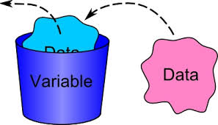
4. Data description
station_avg_temp_c : average temperature (Predictor)
station_precip_mm : total precipitation (Predictor)
station_diur_temp_rng_c : diurnal temperature (Predictor)
precipitation_amt_mm : total precipitation (Predictor)
reanalysis_sat_precip_amt_mm :total precipitation (Predictor)
reanalysis_dew_point_temp_k :mean dew point temperature (Predictor)

Slide 9
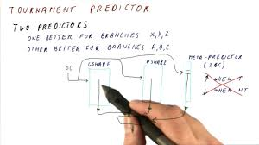
4. Data description
reanalysis_air_temp_k : mean air temperature (Predictor)
reanalysis_relative_humidity_percent : mean relative humidity (Predictor)
reanalysis_specific_humidity_g_per_kg : mean specific humidity (Predictor)
reanalysis_precip_amt_kg_per_m2 : total precipitation (Predictor)
reanalysis_max_air_temp_k : maximum air temperature (Predictor)
reanalysis_min_air_temp_k : minimum air temperature (Predictor)

Slide 10

4. Data description
reanalysis_avg_temp_k :average air temperature (Predictor)
reanalysis_tdtr_k : diurnal temperature range (Predictor)
ndvi_se : pixel southeast of city centroid (Predictor)
ndvi_sw : pixel southwest of city centroid (Predictor)
ndvi_ne : pixel northeast of city centroid (Predictor)
ndvi_nw : pixel northwest of city centroid (Predictor)
total_case: numbers of dengue cases (Predictor)

Slide 11
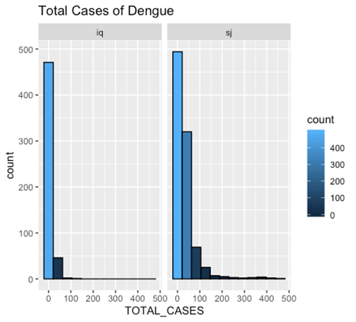
5. Data exploration
Based on histogram, for both the cities, variance of observed total Dengue cases seems to be very large compared to the mean
Spread is wide
A skewed distribution is observed for total cases for both the cities
Hints the need of transforming the response variable for some models

Slide 12
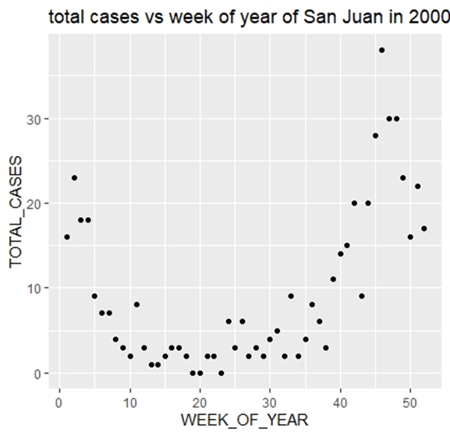
5. Data exploration
Total cases vs week of year of San Juan in 2000
U-shaped association between total cases and week of year
From the first week to twentieth week, it presents negative association
From the twentieth week to fifty-second week, it mainly shows positive association.
Total number of cases is highly associated with the time of the year

Slide 13
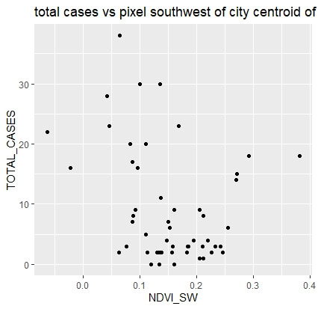
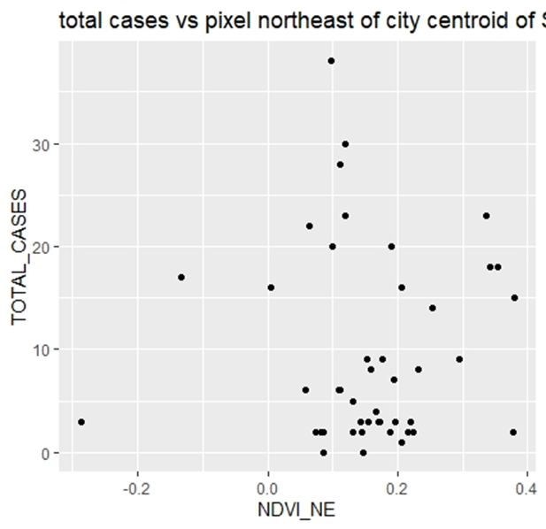
5. Data exploration
Total cases vs vegetation index in San Juan and Iquitos in 2000
There are relatively more infected cases concentrated between vegetation indexes of 0.05-0.25 for both the cities
Vegetation has some association with the number of cases.

Slide 14
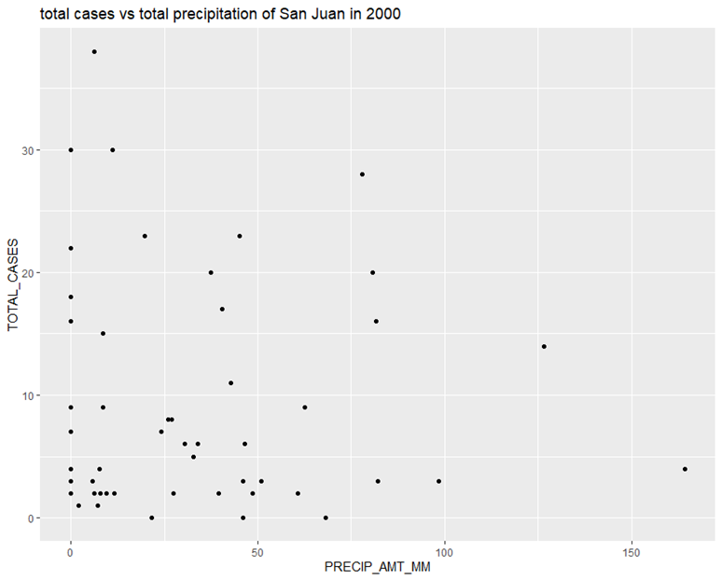
5. Data exploration
Total cases vs total precipitation of San Juan in 2000
1. The number of cases are concentrated between precipitation amounts of 0-50 mm, whereas it dilutes with the increase of precipitation amount.
2. This could hint the fact that it is not very much likely to find frequent higher number of Dengue cases at time when rain fall is very high.
3. On the other hand, there has to be some amount of precipitation, where mosquito larvae can breed and nourish on.

Slide 15
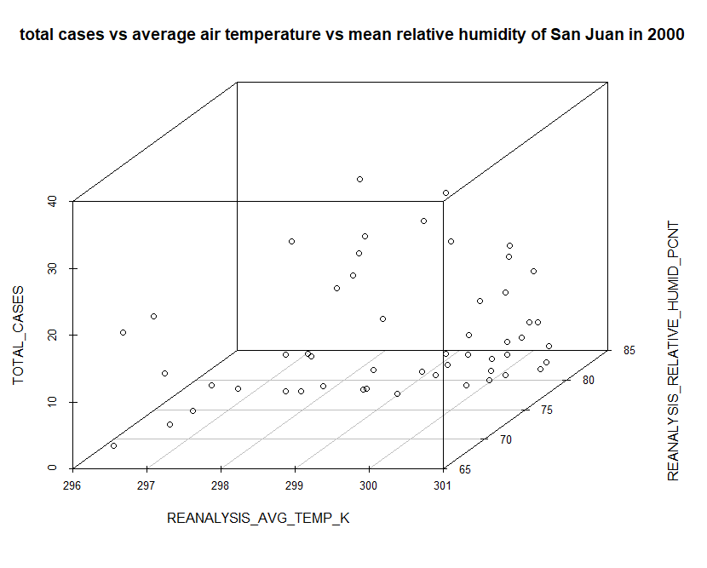
5. Data exploration
Total cases vs average air temperature vs mean relative humidity of San Juan in 2000
1. It could be initially thought there exists certain positive association between total case and mean relative humidity of San Juan in 2000.
2. It could be initially thought there exists certain positive association between total case and average air temperature of San Juan in 2000.
3. There exists positive association between mean relative humidity and average air temperature.

Slide 16
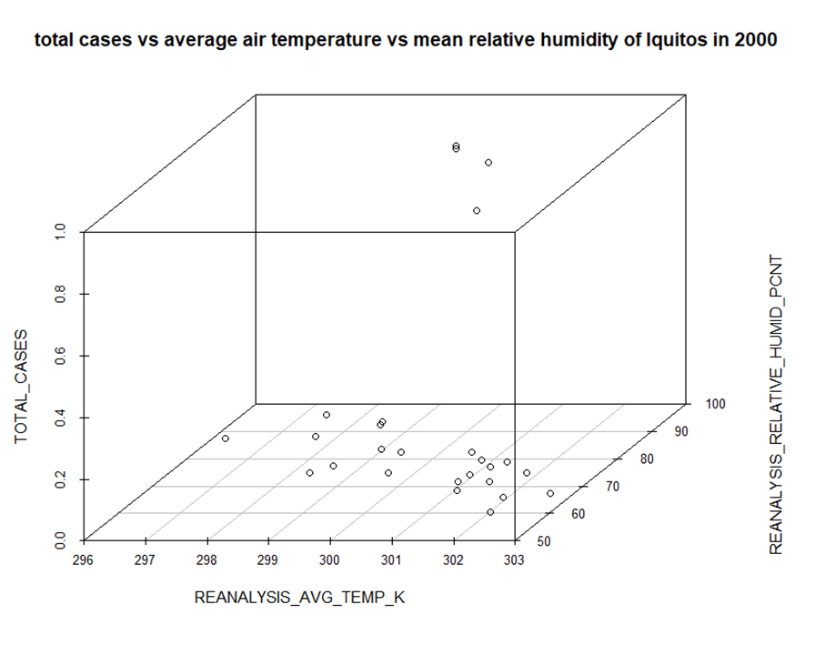
5. Data exploration
Total cases vs average air temperature vs mean relative humidity of Iquitos in 2000
1. It could be initially thought there does not exist linear association among in total cases, mean relatively humid and average air temperature.
2. It seems Dengue had been controlled well in Iquitos in 2000, because there is only 4 cases of Dengue around the whole year in Iquitos.
3. There exists weak and negative association between mean relative humidity and average air temperature.

Slide 17
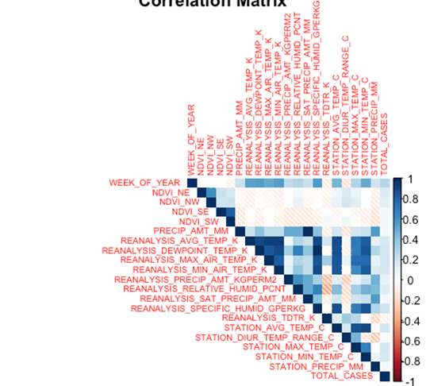
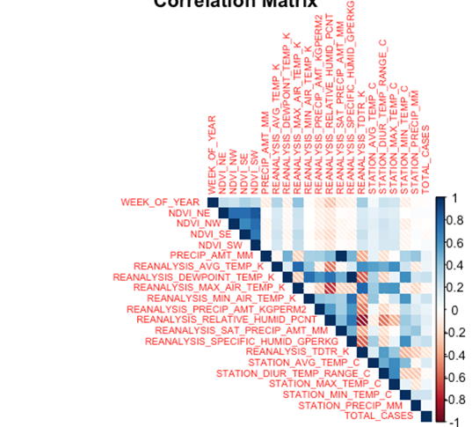
5. Data Exploration Correlation matrix
1. Some predictors are highly correlated with each other
2. Hints the need of dimension reduction
3. No predictor seems to be directly correlating with the total number of cases. Time series nature of data could be the reason for this
4. Hence, predictor-response variable seems to be a complex one
San Juan
Iquitos

Slide 18
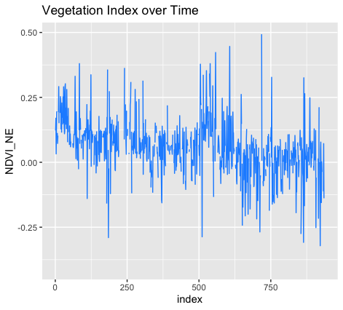

6. Data mining tasks/methods
6.1 Treating noise in data
There is no treatment was done in that aspect, because observation was that all variables are within desired minimum and maximum values.
6.2 Missing data imputation
It is observed that 548 datapoints are missing in the overall dataset, missing values are imputed with the most recent value as values which are in similar time zone are expected to be similar because of time series nature of predictors.
Visualization of missing vegetation indexes between 225-250

Slide 19
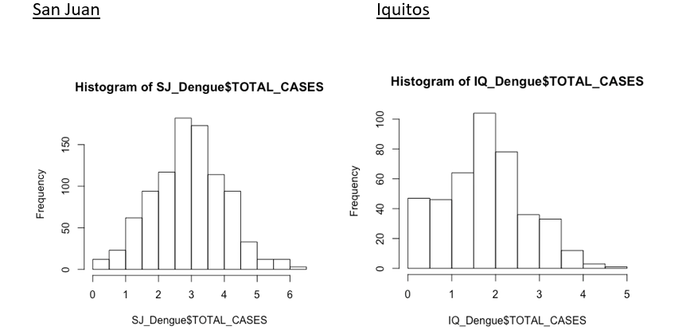
6. Data mining tasks/methods
6.3 Logistic transformation of response variable
log
Log transformed total number of cases seem to be following a normal distribution, which would be better to be used in modelling rather than the initial skewed data.

Slide 20
6. Data mining tasks/methods
6.4 Feature Engineering
Literature review:–
[1] Aziz, T. a. Lukose, D. a. b. A. Bakar, S. a. Sattar and Abdul, "A Literature Review of Methods for Dengue Outbreak Prediction".
[2] Kuno and Goro, "Review of the factors modulating dengue transmission," Epidemiologic reviews, vol. 17, pp. 321-335, 1995.
[3] Y.-H. Hsieh and C. W. S. Chen, "Turning points, reproduction number, and impact of climatological events for multi-wave dengue outbreaks," Tropical Medicine \& International Health, vol. 14, pp. 628-638, 2009.
Following insights were drawn from above articles which supported Feature Engineering.
Dengue transmission depends on changes in Climatic factors like rainfall, temperature humidity etc… and Non-Climatic factors like human growth, movement and socio-economic constraints.
2. Climatic differences affect the incubation period of Larvae ranging from 4-16 weeks.
3. The increases and decreases in Climatic changes affects the number of Dengue cases

Slide 21
6. Data mining tasks/methods
6.4 Feature Engineering
Five new Climatic and Non-Climatic features were introduced to the dataset in order to reach better accuracies in modelling.
1)Number of Dengue cases reported previous week (PRE_WEEK_ CASES)
2)Humidity of previous month (PRE_MONTH_HUMIDITY)
3)Dew point temperature of previous month (PRE_MONTH_DEWPOINT_TEMP)
4)Station average temperature of previous month (PRE_MONTH_STATION_AVG_TEMP)
5)Maximum air temperature of previous month (PRE_MONTH_MAX_AIR_TEMP)

Slide 22
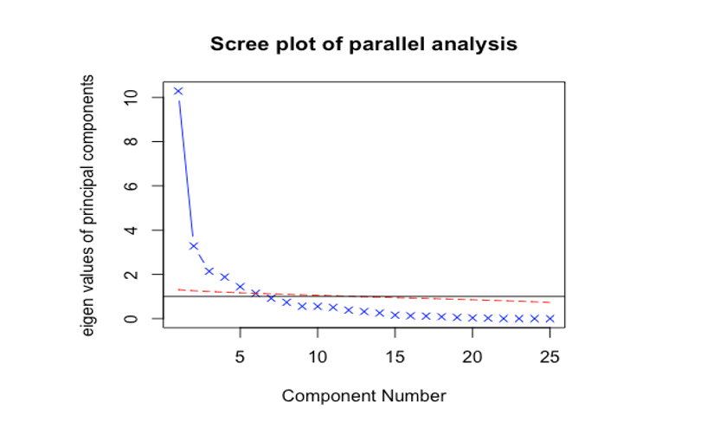
6. Data mining tasks/methods
6.5 Dimension reduction
Scree plots for both the cities suggested the reduction of dimensions to 6 principal components that captured over 90% variance
Hence, principal component scores were calculated for 6 components

Slide 23
6. Data mining tasks/methods
6.6 Classification of number of total Dengue cases
Classification problem was generated by classifying the total number of cases as per below criteria
Total number of cases were binned in to 5 classes as Very Low, Low, Medium, High and Very High as per below criteria.

Slide 24
6. Data mining tasks/methods
Adhering to all the above data mining techniques, modelling was done to following variations of the data set for each city; San Juan and Iquitos.
i. Original data
ii. Combination of original features and added features (Supported by literature review)
iii. Principal components
iv. Heuristically selected subset of variables through literature review, correlation coefficients and plots

Slide 25
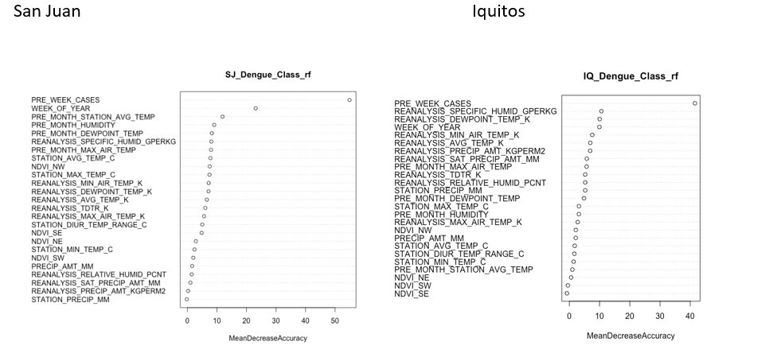
7. Data Mining Models/Methods 7.1 Classification of Dengue cases
7.1.1 Random Forest Classification
Random Forest Classification was done with 600 trees, 7 variables randomly sampled as candidates at each split and keeping 5 as minimum size of terminal nodes. Following is the variable importance plot which depicts that the 5 most prominent features are
PRE_WEEK_CASES,
WEEK_OF_YEAR ,
PRE_MONTH_STATION_AVG_TEMP ,
PRE_MONTH_HUMIDITY ,
PRE_MONTH_DEWPOINT_TEMP.

Slide 26
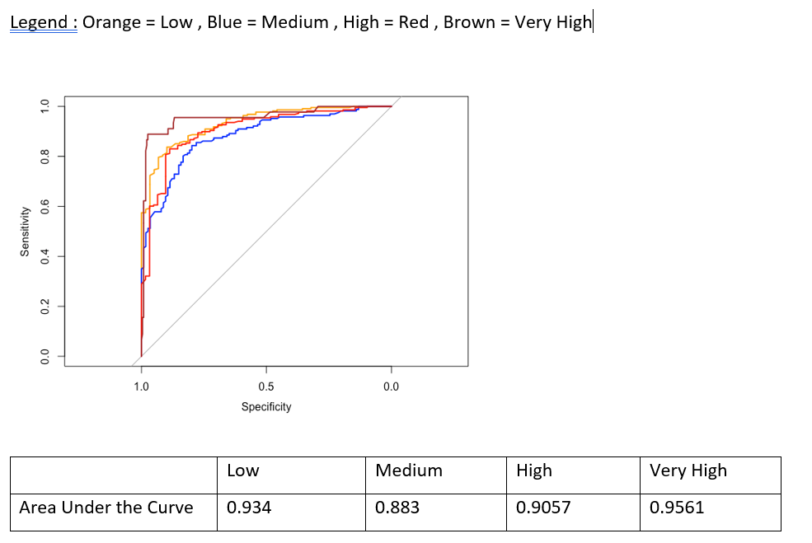
7. Data Mining Models/Methods 7.1 Classification of Dengue cases
7.1.1 Random Forest Classification – San Juan
Accuracy = 0.74 with 95% CI
P-Value < 2.2e-16
Kappa = 0.63
ROC
Area Under the Curve

Slide 27
7. Data Mining Models/Methods 7.1 Classification of Dengue cases
7.1.1 Random Forest Classification – Iquitos
Accuracy = 0.73
P-Value = 0.05
Kappa = 0.37
-Number of cases for class very high is 4.
-Hence, a good classification model which isn’t bias could not be built because of shortage of cases belonging to some classes.

Slide 28

7. Data Mining Models/Methods 7.1 Classification of Dengue cases
7.1.2 K-Nearest Neighbors- San Juan
Number of neighbors from 1 to 14 were tested to arrive at the ideal number of neighbors for the model for each city. K was selected in such a way that it does not overfit the model as well as does not ignore local structure and the ideal number of neighbors turned out to be 8.

Slide 29
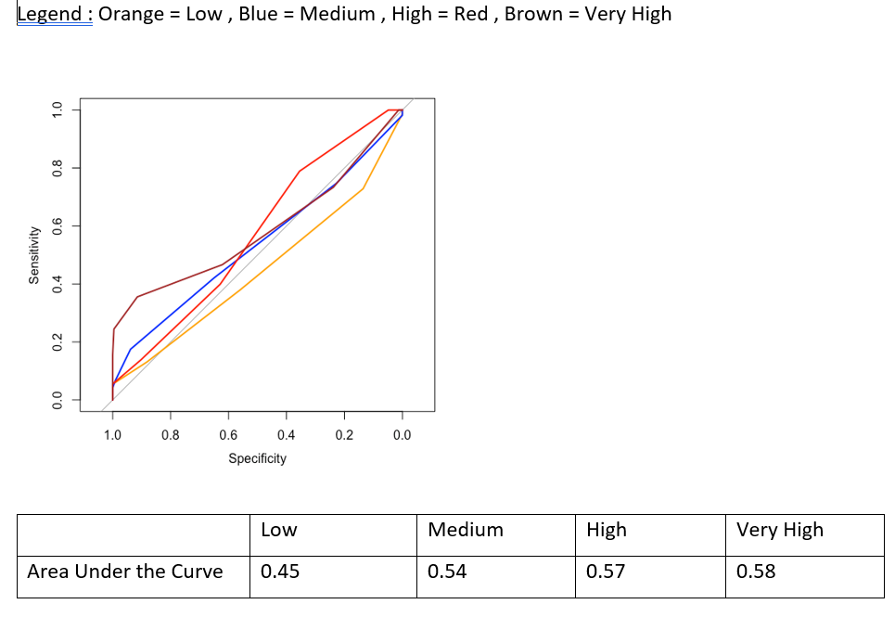
7. Data Mining Models/Methods 7.1 Classification of Dengue cases
7.1.2 K-Nearest Neighbors-San Juan
Accuracy = 0.54 with 95% CI
P-Value < 9.54e-06
Kappa = 0.32

Slide 30
7. Data Mining Models/Methods 7.1 Classification of Dengue cases
7.1.3 Discriminant Analysis – San Juan
Discriminant analysis was done to the features in the table, which were heuristically selected.
Following function was derived with most prominent features
 | High | Low | Medium | Very High
constant | -5.146981e+06 | -5.148011e+06 | -5.14763e+06 | -5.14698e+06
WEEK_OF_YEAR | 3.222564e+01 | 3.218842e+01 | 3.219229e+01 | 3.222305e+01
REANALYSIS_DEW_POINT_TEMP_K | 3.696052e+04 | 3.696421e+04 | 3.696286e+04 | 3.696051e+04
REANALYSIS_SCPECIFIC_HUMID_GPERKG | -3.798538e+04 | -3.798922e+04 | -3.79879e+04 | -3.79852e+04
STATION_MAX_TEMP_C | 1.705876e+02 | 1.707535e+02 | 1.706001e+02 | 1.706360e+02
PRE_WEEK_CASES | -3.360654 | -3.378060 | -3.372086 | -3.314213
PRE_MONTH_HUMIDITY | 6.033990 | 6.033440 | 6.035363 | 6.034671
Accuracy = 0.54
P-Value < 0.54e06
Kappa = 0.32
 | Low | Medium | High | Very High
Sensitivity | 0.31 | 0.73 | 0.40 | 0.53
PPV | 0.47 | 0.53 | 0.45 | 0.83

Slide 31
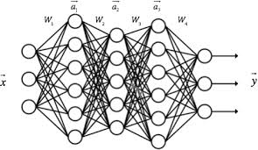
7. Data Mining Models/Methods 7.1 Classification of Dengue cases
7.1.4 Neural Networks
A neural network was build using principal components as predictors and Total Cases class as response variable. Input layer comprised of 6 nodes (the six principal components), one hidden layer was exercised with 6 nodes and the output layer comprised of 4 nodes which represent the 4 classes. Algorithm “backpropagation” was used with logistic activation function in the architecture of the neural network and 5 fold cross validation was used throughout in building the model as neural networks are so much prone to overfitting.
The model didn’t show any performance, owing to lack of data points to do 4 class classification.

Slide 32
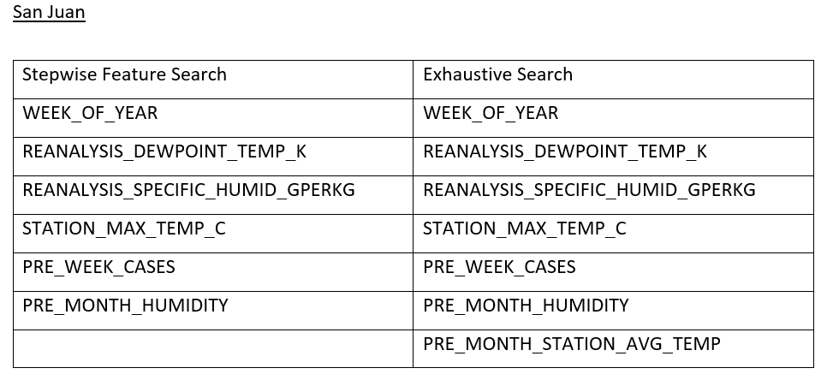
7. Data Mining Models/Methods 7.2 Prediction of total number of Dengue cases
7.2.1 Multiple Linear Regression – San Juan
Model 1 (Using stepwise feature selection) :
TOTAL_CASES = 33.5042 + 1.8107 * WEEK_OF_YEAR - 24.9751 * REANALYSIS_DEWPOINT_TEMP_K + 26.5415 * REANALYSIS_SPECIFIC_HUMID_GPERKG + 1.8695 * STATION_MAX_TEMP_C + 45.0145 * PRE_WEEK_CASES - 2.4380 * PRE_MONTH_HUMIDITY
Model 2 (Using exhaustive search) :
TOTAL_CASES = 33.4947 + 1.7758 * WEEK_OF_YEAR - 25.4482 * REANALYSIS_DEWPOINT_TEMP_K + 26.7668 * REANALYSIS_SPECIFIC_HUMID_GPERKG + 1.6345 * STATION_MAX_TEMP_C + 44.9644 * PRE_WEEK_CASES - 3.8788 * PRE_MONTH_HUMIDITY + 1.9315 * PRE_MONTH_STATION_AVG_TEMP

Slide 33
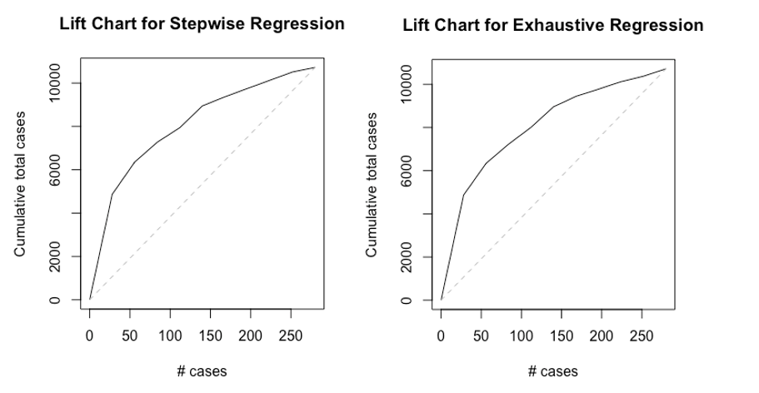
7. Data Mining Models/Methods 7.2 Prediction of total number of Dengue cases
7.2.1 Multiple Linear Regression – San Juan
The multiple linear regression models developed which incorporated stepwise feature search and exhaustive feature search are observed to be equally performing when considering their accuracies and lift charts.

Slide 34
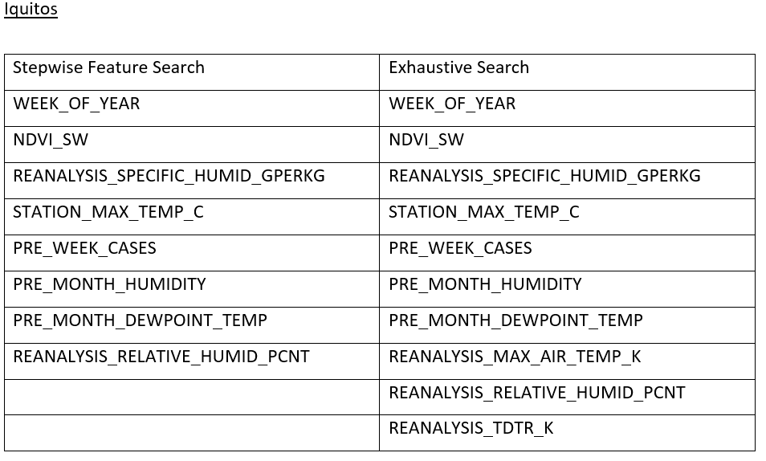
7. Data Mining Models/Methods 7.2 Prediction of total number of Dengue cases
7.2.1 Multiple Linear Regression – Iquitos
Model 1 (Using stepwise feature selection) :
TOTAL_CASES = 7.1571 - 0.8156 * WEEK_OF_YEAR + 1.0217 * NDVI_SW - 1.9507 * REANALYSIS_MAX_AIR_TEMP_K - 2.2997 * REANALYSIS_RELATIVE_HUMID_PCNT + 1.7450 * REANALYSIS_SPECIFIC_HUMID_GPERKG + 0.5936 * STATION_MAX_TEMP_C + 5.7477 * PRE_WEEK_CASES - 8.1030 * PRE_MONTH_HUMIDITY + 7.6790 * PRE_MONTH_DEWPOINT_TEMP
Model 2 (Using exhaustive search) :
TOTAL_CASES = 7.1621 - 0.7678 * WEEK_OF_YEAR + 0.9751 * NDVI_SW - 1.5752 * REANALYSIS_MAX_AIR_TEMP_K - 2.9440 * REANALYSIS_RELATIVE_HUMID_PCNT + 1.6984 * REANALYSIS_SPECIFIC_HUMID_GPERKG - 1.0600 * REANALYSIS_TDTR_K + 0.5291 * STATION_MAX_TEMP_C + 5.7574 * PRE_WEEK_CASES - 8.0868 * PRE_MONTH_HUMIDITY + 7.5815 * PRE_MONTH_DEWPOINT_TEMP

Slide 35
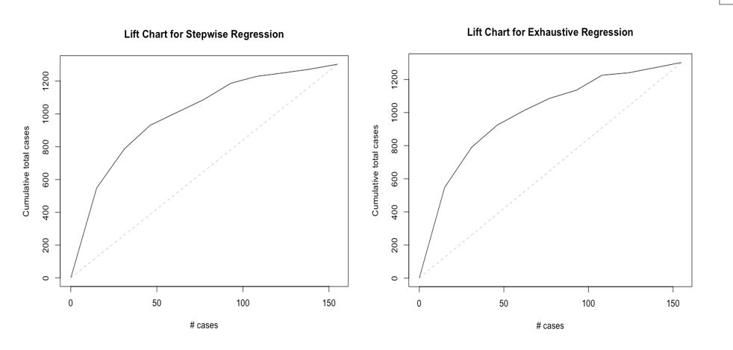
7. Data Mining Models/Methods 7.2 Prediction of total number of Dengue cases
7.2.1 Multiple Linear Regression – Iquitos
The multiple linear regression models developed which incorporated stepwise feature search and exhaustive feature search are observed to be equally performing when considering their accuracies and lift charts.

Slide 36

7. Data Mining Models/Methods 7.2 Prediction of total number of Dengue cases
7.2.2 K-Nearest Neighbors
When all the features were used, the desirable number of neighbors were 6 for both the cities, This figure was selected in such a way that it minimizes error and at the same time causes no overfit.
When using principal components, the desirable number of neighbors were 2 and 3 respectively for the two cities which is justifiable given the lesser number of features

Slide 37
7. Data Mining Models/Methods 7.2 Prediction of total number of Dengue cases
7.2.2 K-Nearest Neighbors
It was decided that the optimal number of neighbors to be evaluated is 6, which gives the following accuracy.
For San Juan:
For Iquitos:

Slide 38
7. Data Mining Models/Methods 7.2 Prediction of total number of Dengue cases
7.2.3 Regression trees
Regression trees were drawn to the two cities under two scenarios.
Scenario 1 :- Dataset with heuristically selected features, based on literature review and correlation coefficient analysis.
Scenario 2:- Principal component scores
Full regression tree done to principal component scores were pruned to attain at the most prominent principal components; PC5, PC3 and PC1 for San Juan and PC3, PC2, PC1, PC6, PC4 for Iquitos

Slide 39
7. Data Mining Models/Methods 7.2 Prediction of total number of Dengue cases
7.2.3 Regression trees
For San Juan:
For Iquitos:

Slide 40
7. Data Mining Models/Methods 7.2 Prediction of total number of Dengue cases
7.2.4 Neural Networks
Two neural networks were done for each city, San Juan and Iquitos. The first was done using heuristically selected features through literature review and correlation analysis and the second was done using principal components. Architectures comprised of one hidden layer with 5 nodes and one output layer which corresponds to the response variable and logistic activation function and backpropagation weight update strategy was used.

Slide 41
7. Data Mining Models/Methods 7.2 Prediction of total number of Dengue cases
7.2.4 Neural Networks
For San Juan:
 | Heuristically selected subset of features | PCA
Mean Absolute Deviation | 27.87 | 33.15
For Iquitos:
 | Heuristically selected subset of features | PCA
Mean Absolute Deviation | 5.27 | 14.17

Slide 42

8. Performance Evaluation
All the models except neural networks use 70% : 30% training validation split for training and performance evaluation purposes. five fold cross validation was used in neural networks with the purpose of avoiding overfitting the model to the training dataset.
The performance matrices and results are given in the modelling section above for better clarity

Slide 43
9. Project Results
9.1 Performance comparison and final model selection for Problem 1.1 (Classification for San Juan)
 | Accuracy | Kappa | Max AUC | Min AUC
Random Forest Classification | 0.74 | 0.63 | 0.95 | 0.88
K-Nearest Neighbors | 0.54 | 0.32 | 0.58 | 0.45
Neural Networks | 0.7
Discriminant Analysis | 0.53 | 0.30 | 0.55 | 0.44
-Data isn’t enough for some categories to run neural network. Hence, there is almost no performance in the model.
-The model with highest accuracy, kappa and max and min values is selected as the final model.
Selected model = Random Forest Classification

Slide 44
9. Project Results
9.2 Performance comparison and final model selection for Problem 1.2 (Prediction for San Juan)
Selected model = Pruned Regression Tree, because KNN would be tricky with large datasets when putting it into use because of its high computational time.
 | Mean Absolute Error
Multiple Linear Regression - Stepwise | 13.286
Multiple Linear Regression – Exhaustive Search | 13.281
K Nearest Neighbors – All Features | 6.63
K Nearest Neighbors – Principal components | 18.76
Pruned Regression Tree | 11.79
Regression Tree – Principal components | 15.9
Neural Network – Selected features | 27.87
But KNN with all the features including added features during feature engineering process could also be used with small datasets.

Slide 45
9. Project Results
9.3 Performance comparison and final model selection for Problem 2.1 (Classification for Iquitos)
It was found out that only 4 data points are available for the class “Very High”, which was not enough to build any model as oversampling is also not possible with such a small number of cases !

Slide 46
9. Project Results
9.4 Performance comparison and final model selection for Problem 2.2 (Prediction for Iquitos)
 | Mean Absolute Error
Multiple Linear Regression - Stepwise | 5.27
Multiple Linear Regression – Exhaustive Search | 5.27
K Nearest Neighbors – All Features | 3
K Nearest Neighbors – Principal components | 8.74
Pruned Regression Tree | 5.3
Regression Tree – Principal components | 8.85
Neural Network – Selected features | 5.27
Selected model = Multiple Linear Regression, Neural Networks or Pruned Tree, because, there might be computational difficulties with large datasets.

Slide 47
10. Insights for Decision Making
1. The data mining task of feature engineering done has proven to have significant impacts on the models built in terms of performance increments. Climate factors such as the humidity a month ago, temperature and non-climatic factors such as number of cases in previous week make considerable impact on the number of cases in the target week. This is a very valuable insight which helps the decision makers to get an idea on the expected number of cases in coming weeks by observing existing climate conditions and case numbers.

Slide 48
10. Insights for Decision Making
2. The two cities San Juan and Iquitos perform differently even though the basic structure is the same. Model parameters for each city varies from one another by considerable amounts. Moreover, number of cases in Iquitos seem to have higher association with vegetation, which is not a relationship seen in San Juan. Hence, an insight can be drawn that the cities behave differently, owing to geographical differences.

Slide 49
10. Insights for Decision Making
3. KNN model performing better hints that distance matrix of predictor parameters have a considerable impact on total number of cases and are of course closely connected with the response variable.

Slide 50
11. Impact of the Project Outcomes
Through the above insights, healthcare sector and other related sectors of any city can be better prepared for the surges of the Dengue epidemic, which results in :-
Ensuring lesser mortality rates
Preventive actions which helps to keep the numbers down
Increasing quality of healthcare service
Increasing drug availability and reducing deficiencies of the same
Avoiding supply chain disturbances
Reducing adverse economic impacts through prior availability of information

Slide 51
THANK YOU!

